Slide 1
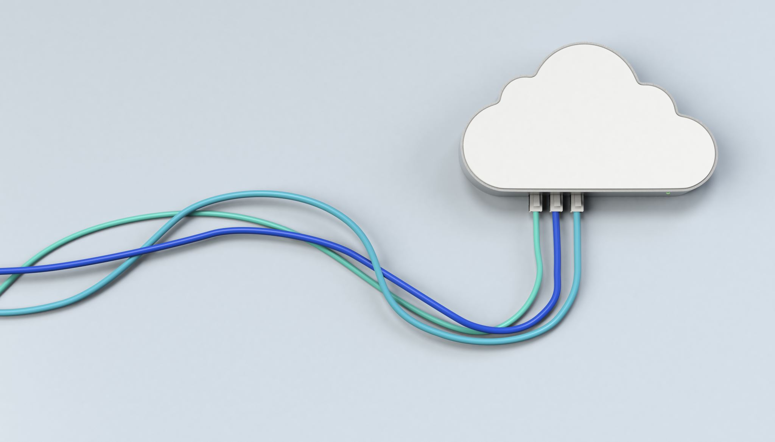
CHAPTER 8 Resource Pooling, Sharing and Provisioning
|Cloud Computing

Slide 2
Pooling – Sharing – Provisioning
Resource Pooling
Resource pooling is a core feature of cloud computing that allows cloud providers to serve multiple clients using shared physical resources.
Key Concepts:
Resources like computing power, storage, and network bandwidth are virtualized and pooled.
Clients use these virtual resources without being aware of the underlying physical infrastructure.
Key Benefits:
Increased resource utilization.
Cost-efficiency by eliminating idle resources.
Flexibility to meet fluctuating demands.
Example: Multiple virtual machines (VMs) running on a single physical server.
Resource Sharing
Resource sharing allows multiple clients or workloads to use the same set of physical resources.
Benefits:
Higher Utilization Rates: Shared resources ensure maximum usage of physical infrastructure, reducing idle time.
Cost Efficiency: Instead of each client needing separate resources, they share resources, driving down costs.
Elasticity: Resources are dynamically allocated based on demand.
Example: A cloud provider like AWS or Azure shares physical servers among numerous clients using virtualization technologies.
Dynamic Resource Provisioning
Dynamic Provisioning: The ability of the cloud provider to allocate or release resources on demand, ensuring the right amount of resources is available at any time.
How It Works:
Resources are provisioned when an application or client needs more capacity.
Resources are de-provisioned when demand decreases, ensuring efficiency.
Advantages:
No need for over-provisioning hardware.
Reduces costs and improves agility.
Perfect for workloads with varying resource demands.
Example: A retail website may require more server capacity during the holiday season and less afterward.

Slide 3
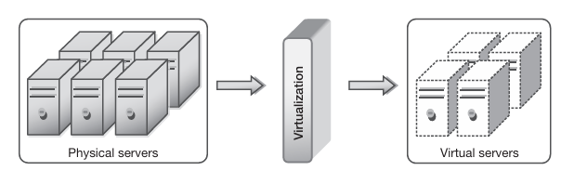
Resource Pooling Architecture
Resource Pools: Collections of virtualized resources that include processing power, memory, storage, and networking.
Components:
Compute Pool: Virtual servers that run applications and workloads.
Storage Pool: Virtualized storage that is allocated to users.
Network Pool: Virtual networking resources like bandwidth and routers.
How It Works:
Resources from physical machines are abstracted into a virtual pool.
This pool can dynamically allocate resources to VMs or containers.

Slide 4
Computer and Server Pools in Cloud Data Centers
Definition: A collection of physical servers that host virtualized computing environments.
Process:
Physical machines are grouped into a compute pool.
Virtual machines (VMs) or containers are created from these servers.
Resources like CPU and memory are allocated based on demand.
Benefits:
Efficient resource utilization.
Easy scalability by adding more servers to the pool.
Example: A company using multiple VMs to run different applications from a shared server pool.

Slide 5
Storage Pools in Cloud Environments
Storage Pool: A virtualized collection of physical storage devices (e.g., SSDs, HDDs) that act as a single storage unit.
How It Works:
Cloud providers pool storage from multiple devices to create virtual disks for users.
Data from various users are stored on the same physical storage but are isolated at the virtual layer.
Benefits:
Storage can be expanded or reduced without physical reconfiguration.
Higher availability and reliability through redundancy (e.g., RAID configurations).
Example: Google Cloud Storage providing scalable object storage for applications.

Slide 6
Network Pools in Cloud Data Centers
Network Pool: A collection of virtualized network components, including routers, switches, and firewalls.
How It Works:
Virtual networks (VLANs) are created by pooling physical networking equipment.
Users can configure their own virtual networks within the cloud.
Benefits:
Simplifies networking in large, complex environments.
Increases security through network segmentation.
Example: Amazon VPC (Virtual Private Cloud) allows users to define their own isolated networks in the cloud.

Slide 7
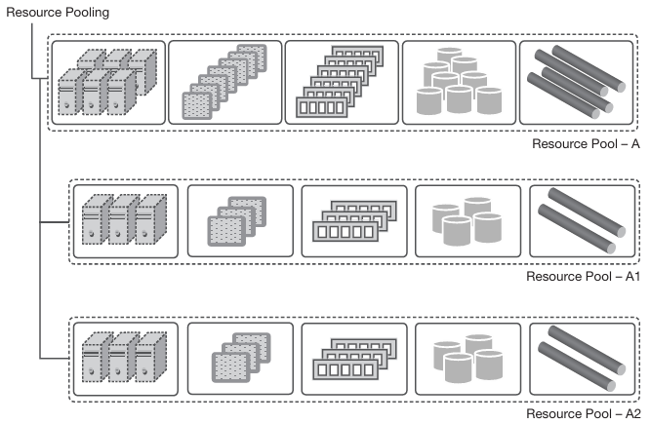
Hierarchical Organization of Resource Pools
Hierarchy of Pools: Resource pools are often organized into sub-pools for better management and scalability.
Structure:
Parent Pools: Larger pools containing resources for broader use.
Sub-pools: Smaller pools within the parent pools for specific purposes (e.g., different applications).
Benefits:
Enhanced scalability.
Fault tolerance by distributing workloads across multiple pools.
Efficient management of diverse workloads.
Example: An enterprise cloud may have a parent compute pool with sub-pools for different departments or applications.

Slide 8
Commoditization of Data Centers
Commoditization: Cloud providers use inexpensive, standardized hardware (commodity servers) instead of specialized hardware.
Key Features:
Lower cost of hardware.
Easy replacement and scalability.
Cloud platforms are built to handle hardware failures without affecting service.
Benefits:
Reduces capital expenditure for cloud providers.
Increases scalability as commodity hardware is easily replaceable.
Example: Facebook and Google’s data centers largely rely on commodity hardware for their cloud services.

Slide 9
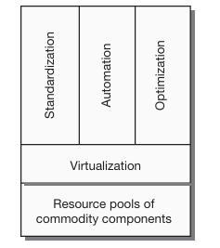
Standardization, Automation, and Optimization
Standardization: Uniform resource types (CPU, memory, storage) across the cloud environment ensure compatibility and predictability.
Automation: Cloud systems automatically manage resource allocation, monitoring, scaling, and recovery.
Optimization: Continuous adjustments to resource allocation ensure efficient use of resources while maintaining performance.
Benefits:
Reduces manual intervention.
Ensures optimal performance with minimal cost.
Example: Automatic horizontal scaling of VMs when traffic increases on a web app.

Slide 10
Resource Sharing
Multiple clients or applications share physical resources while maintaining isolation through virtualization.
Challenges:
Resource contention can affect performance.
Ensuring fair distribution of resources to all clients.
Solutions:
Performance Isolation: Techniques like capping resource usage for each client.
QoS Guarantees: Contracts that ensure clients get a minimum level of service.
Example: Virtual machines on AWS sharing CPU cores, but each VM gets a dedicated memory pool.

Slide 11
Multi-Tenancy in Cloud Computing
Definition: A single instance of a cloud platform serves multiple customers (tenants), with data and applications logically separated.
Public Cloud Example:
Users share infrastructure, but their resources are isolated through virtualization.
Benefits:
Cost-effective for cloud providers.
Tenants can scale without affecting each other.
Challenges:
Ensuring security and performance isolation between tenants.
Example: Salesforce.com, where each organization using the service has isolated data and applications on a shared infrastructure.

Slide 12
Challenges of Resource Sharing
Performance Issues:
Contention for CPU, memory, or network resources can degrade application performance.
Ensuring Quality of Service (QoS) in shared environments.
Solutions:
Virtual Machine Monitor (VMM): Manages resource allocation among VMs.
Load Balancing: Dynamically redistributes workloads to avoid bottlenecks.
Future Direction: Use of AI/ML algorithms to predict resource needs and optimize allocation in real-time.
Example: Google Cloud’s use of AI-based optimizations for real-time resource management.

Slide 13
Resource Provisioning
Traditional computing requires significant time and effort for provisioning servers.
Modern computing leverages cloud and virtualization for rapid provisioning.
Cloud enables flexible, dynamic, and self-service provisioning of resources.
Benefits of Cloud Resource Provisioning:
Saves time and reduces administrative overhead.
Flexible and dynamic allocation of resources.
Virtual machine provisioning enables rapid deployment.
Resources can be provisioned through a self-service interface.

Slide 14
Autonomic Resource Provisioning
Automated process using artificial intelligence (AI).
Cloud providers allocate resources based on demand.
Resources are pooled and shared, allowing dynamic allocation.
Minimizes resource waste and optimizes application performance.

Slide 15
Role of SLAs in Resource Provisioning
SLAs define the expected resource capacity for applications.
Cloud providers plan resources based on combined SLAs.
Provisioning algorithms dynamically map VMs to physical resources.
Efficient resource estimation ensures smooth performance.

Slide 16
Resource Provisioning Approaches
Static Resource Provisioning
Suitable for predictable workloads.
Resource allocation happens once during application start.
No runtime decision overhead but cannot adapt to changing demands.
Can lead to over-provisioning or under-provisioning issues.
Dynamic Resource Provisioning
Resources allocated and de-allocated based on current demand.
Provides elasticity, enabling applications to scale up or down.
Resources are pooled and shared, minimizing wastage.
Suitable for fluctuating workloads but introduces runtime decision overhead.
Hybrid Resource Provisioning
Combines static and dynamic approaches.
Initial resource allocation is static; dynamic adjustments occur during runtime.
Addresses the challenges of real-time workload changes.
Balances resource utilization and system performance.

Slide 17
Comparison of Static and Dynamic Provisioning
Static Provisioning:
One-time resource allocation.
No elasticity or scaling.
No runtime overhead.
Dynamic Provisioning:
Resources adjusted based on demand.
Elastic and scalable.
Runtime overhead due to resource allocation decisions.

Slide 18
Over & Under Resource Provisioning
Resource Under-provisioning
Occurs when resources are insufficient for application demand.
Leads to performance degradation and application slowdowns.
Requires careful planning to prevent resource shortages.
Often addressed with dynamic provisioning techniques.
Resource Over-provisioning
Resources exceed actual demand, leading to wastage.
Increases costs without benefiting performance.
Common in static provisioning models to avoid under-provisioning.
Dynamic provisioning mitigates this issue by returning unused resources to the pool.

Slide 19
Cloud Resource Provisioning Plans
Short-Term On-Demand Plan:
Resources are provisioned as needed, with pay-per-usage pricing.
Dynamic provisioning approach, ideal for fluctuating demand.
Long-Term Reservation Plan:
Resources are reserved in advance, reducing computational complexity.
Fixed pricing for a set period, suitable for predictable workloads.

Slide 20
VM Sizing in Cloud Computing
Correct sizing of VMs is essential for optimal resource utilization.
Over-provisioning and under-provisioning can lead to inefficiencies.
Dynamic VM provisioning ensures resources match real-time demand.
Proper VM sizing helps balance cost and performance.

